Slide 1
The Bitcoin network

Slide 2
Bitcoin P2P network
Ad-hoc protocol (runs on TCP port 8333)
Ad-hoc network with random topology
All nodes are equal
New nodes can join at any time
Forget non-responding nodes after 3 hr

Slide 3
Race conditions
Transactions or blocks may conflict
Default behavior: accept what you hear first
Network position matters
Miners may implement other logic!
Stay tune for our lecture on mining!

Slide 4
Block propagation nearly identical
Relay a new block when you hear it if:
Block meets the hash target
Block has all valid transactions
Run all scripts, even if you wouldn’t relay
Block builds on current longest chain
Avoid forks
Sanity check
Also may be ignored...

Slide 5
How big is the network?
Impossible to measure exactly
Estimates-up to 1M IP addresses/month
Only about 5-10k “full nodes”
Permanently connected
Fully-validate
This number may be dropping!

Slide 6
Fully-validating nodes
Permanently connected
Store entire block chain
Hear and forward every node/transaction

Slide 7
Tracking the UTXO set
Unspent Transaction Output
Everything else can be stored on disk
Currently ~12 M UTXOs
Out of 44 M transactions
Can easily fit into RAM

Slide 8
Thin/SPV clients (not fully-validating)
Idea: don’t store everything
Store block headers only
Request transactions as needed
To verify incoming payment
Trust fully-validating nodes
1000x cost savings! (20 GB-23MB)
Notes:
Also called “lightweight nodes”
SPV “Simplied Payment Verification”

Slide 9
Limitations & improvements

Slide 10
Hard-coded limits in Bitcoin
10 min. average creation time per block
1 M bytes in a block
20,000 signature operations per block
100 M satoshis per bitcoin
23M total bitcoins maximum
50,25,12.5... bitcoin mining reward
These affect economic balance of power too much to change now

Slide 11
Throughput limits in Bitcoin
1 M bytes/block (10 min)
>250 bytes/transaction
7 transactions/sec ☹
Compare to:
VISA: 2,000-10,000 transactions/sec
PayPal: 50-100 transaction/sec

Slide 12
Cryptographic limits in Bitcoin
Only 1 signature algorithm (ECDSA/P256)
Hard-coded hash functions
Crypto primitives might break by 2040...

Slide 13
“Hard-forking” changes to Bitcoin
5
1
Block 23
Block 24
Block 23
7
8
Block 24
That’s crazy talk!!
Block 23
That’s crazy talk!!
Block 24
Block 23
24
I found a nifty new block!
3
6
24
2
Block 23
Block 24
Block 23
Block 23
24
4
24
Block 23
PROBLEM: Old nodes will never catch up
Block 24
Notes:
1. Hard-Fork is radical change to the protocol that makes previously invalid blocks/transactions valid (or vice-versa).
2. Soft-Fork is software upgrade that is backward compatible with previous versions of the software

Slide 14
Soft forks
Observation: we can add new features which only limit the set of valid transactions
Need majority of nodes to enforce new rules
Old nodes will approve
RISK: Old nodes might mine now-invalid blocks

Slide 16


CS-482: Introduction to Blockchain and CryptoCurrency
Lecture # 5: How to Store and Use Bitcoins
Prof. Dr. Sufian Hameed
Department of Computer Science
FAST-NUCES

Slide 17
Simple Local Storage

Slide 18
To spend a Bitcoin, you need to know:
* some info from the public blockchain, and
* the owner’s secret signing key
So it’s all about key management.

Slide 19
How to Store and Use Bitcoins
Secret Keys

Slide 20
Goals
availability: You can spend your coins.
security: Nobody else can spend your coins.
convenience

Slide 21
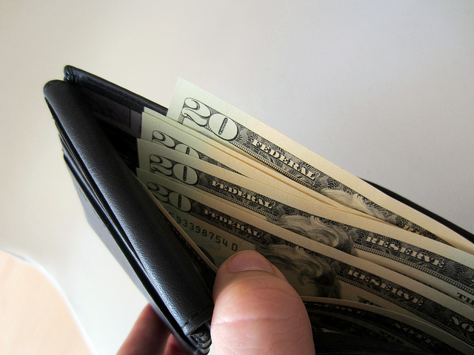
Simplest approach: store key in a file,
on your computer or phone
Very convenient.
As available as your device.
device lost/wiped ⇒ key lost ⇒ coins lost
As secure as your device.
device compromised ⇒ key leaked ⇒ coins stolen
Notes:
Not adequate for most people. Certainly not for companies/services. So we see lots of methods to try to improve/change the tradeoff between convenience, security, availability. Also privacy.

Slide 22
Wallet software
Keeps track of your coins, provides nice user interface.
Nice trick: use a separate address/key for each coin.
benefits privacy (looks like separate owners)
wallet can do the bookkeeping, user needn’t know

Slide 23
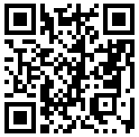
Encoding addresses
Encode as text string: base58 notation
123456789ABCDEFGHJKLMNPQRSTUVWXYZabcdefghijkmnopqrstuvwxyz
or use QR code

Slide 24
Hot and Cold Storage

Slide 25
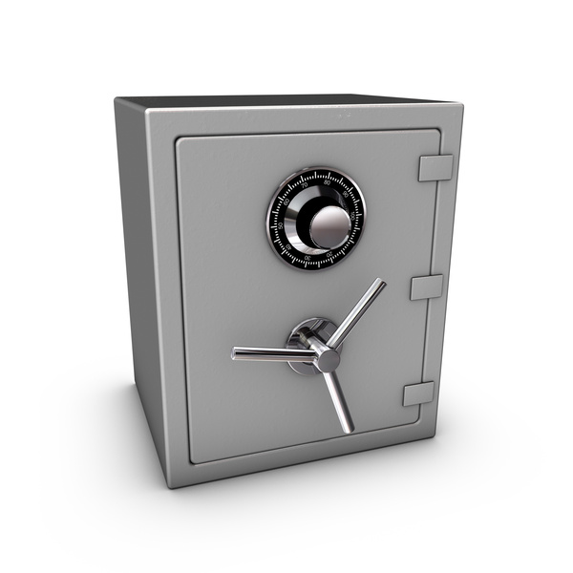
Hot storage
Cold storage
online
offline
convenient but risky
archival but safer
separate keys

Slide 26
Hot storage
Cold storage
online
offline
hot secret key(s)
payments
cold secret key(s)
cold address(es)
hot address(es)

Slide 27
Hot storage
Cold storage
online
hot secret key(s)
payments
cold address(es)
offline

Slide 28
Problem:
Want to use a new address (and key) for each coin sent to cold
But how can hot wallet learn new addresses if cold wallet is offline?
Awkward solution:
Generate a big batch of addresses/keys, transfer to hot beforehand
Better solution:
Hierarchical wallet

Slide 29
Regular key generation:
address
generateKeys
private key

Slide 30
Hierarchical key generation:
i
doesn’t leak keys
address
gen info
i^{th}
address
genAddr
generateKeysHier
private key
gen info
i^{th}
key
genKey
i

Slide 31
hot side
i
address
gen info
i^{th}
address
genAddr
generateKeysHier
private key
gen info
i^{th}
key
genKey
cold side
i

Slide 32
How to store cold info
(1) Info stored in device, device locked in a safe
(2) “Brain wallet”
encrypt info under passphrase that user remembers
(3) Paper wallet
print info on paper,
lock up the paper
(4) In “tamperproof” device
device will sign things for you, but won’t divulge keys
Notes:
Highlight activity of stealing these

Slide 33
Splitting and Sharing Keys

Slide 34
Secret sharing
Good: Store shares separately, adversary must
compromise several shares to get the key.
Bad: To sign, need to bring shares together,
reconstruct the key. ⇐ vulnerable

Slide 35
Multi-sig
Recall multi-sig from Lecture 3.
Lets you keep shares apart, approve transaction without reconstructing key at any point.

Slide 36
Example
Andrew, Arvind, Ed, and Joseph are co-workers.
Their company has lots of Bitcoins.
Each of the four generates a key-pair,
puts secret key in a safe, private, offline place.
The company’s cold-stored coins use multi-sig, so that three of the four keys must sign to release a coin.

Slide 37
Online Wallets and Exchanges

Slide 38
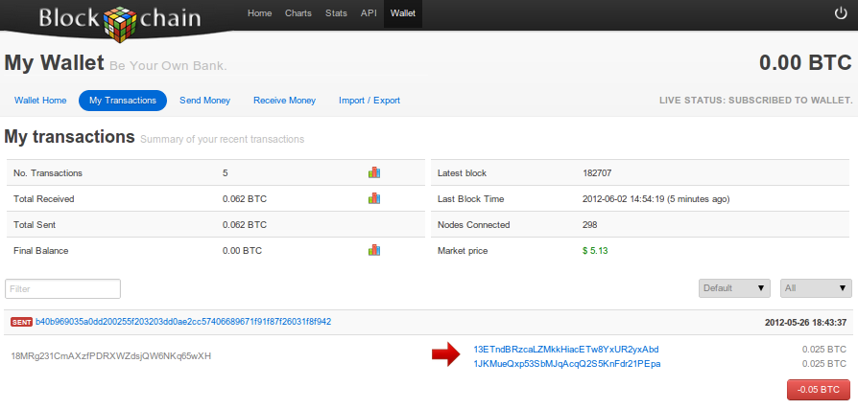
Online wallet
like a local wallet
but “in the cloud”
runs in your browser
site sends code
site stores keys
you log in to access wallet

Slide 39
Online wallet tradeoffs
convenient: nothing to install, works on multiple devices
but security worries
vulnerable if site is malicious or compromised
ideally, site is run by security professionals

Slide 40
Bank-like services
you give the bank money (a “deposit”)
bank promises to pay you back later, on demand
bank doesn’t actually keep your money in the back room
typically, bank invests the money
keeps some around to meet withdrawals (“fractional reserve”)

Slide 41
Bitcoin Exchanges
accept deposits of Bitcoins and fiat currency ($, €, …)
promise to pay back on demand
lets customers:
make and receive Bitcoin payments
buy/sell Bitcoins for fiat currency
typically, match up BTC buyer with BTC seller

Slide 42
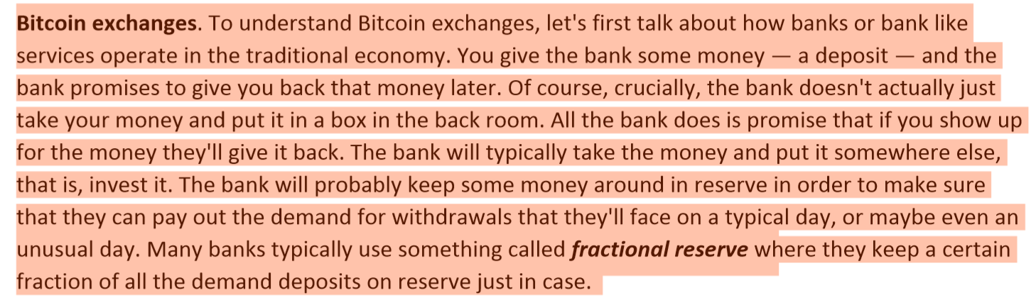

Slide 43
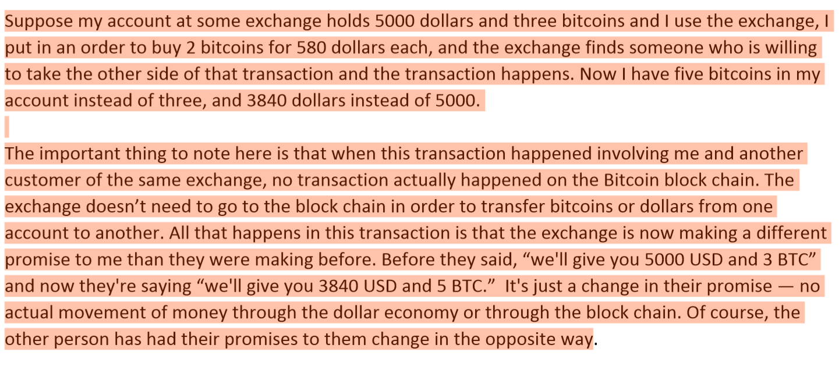

Slide 44
What happens when you buy BTC
suppose my account at Exchange holds $5000 + 3 BTC
I use Exchange to buy 2 BTC for $580 each
result: my account holds $3840 + 5 BTC
note: no BTC transaction appears on the blockchain
only effect: Exchange is making a different promise now

Slide 45
Exchanges: Pros and Cons
pro: connects BTC economy to fiat currency economy
easy to transfer value back and forth
con: risk
same kinds of risks as banks

Slide 46
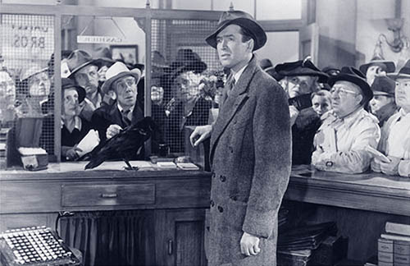
Notes:
Bank Run

Slide 47

Charles Ponzi

Slide 48


Slide 49
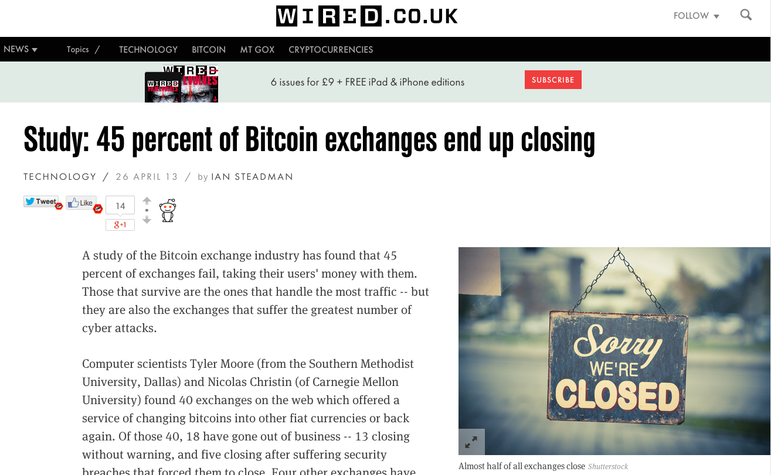

Slide 50
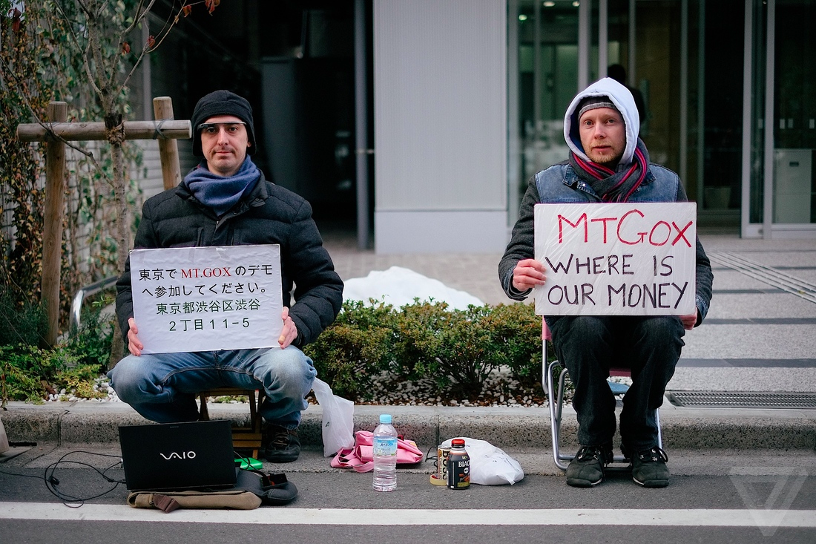

Slide 51
Bank Regulation
for traditional banks, government typically:
imposes minimum reserve requirements
must hold some fraction of deposits in reserve
regulates behavior, investments
insures depositors against losses
acts as lender of last resort
Notes:
Reserve requirement in the U.S. is typically 3-10%.

Slide 52
Proof of Reserve
Bitcoin exchange can prove it has fractional reserve.
fraction can be 100%
Prove how much reserve you’re holding:
publish valid payment-to-self of that amount
sign a challenge string with the same private key
Prove how many demand deposits you hold: ...

Slide 53
Merkle tree with subtree totals
each hashpointer includes total value in its subtree
H( ) H( )
H( ) H( )
H( ) H( )
H( ) H( )
H( ) H( )
H( ) H( )
H( ) H( )
user1
acct
user2
acct
user3
acct
user4
acct
user5
acct
user6
acct
user7
acct
user8
acct

Slide 54
Checking that you’re represented in the tree
show O(log n) items
H( ) H( )
H( ) H( )
H( ) H( )
your
acct

Slide 55
Proof of Reserve
Prove that you have at least X amount of reserve currency
Prove that customers have at most Y amount deposited
So reserve fraction ≥ X / Y

Slide 56
Payment Services

Slide 57
Scenario: merchant accepts BTC
customer wants: to pay with Bitcoin
merchant wants:
* to receive dollars
* simple deployment
* low risk (tech risk, security risk, exchange rate risk)

Slide 58
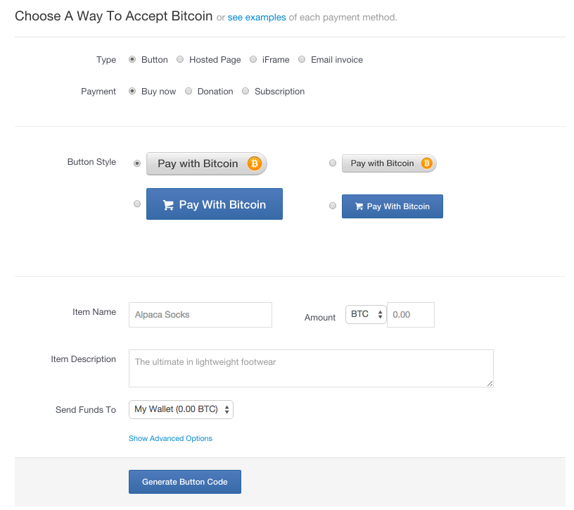
HTML for
payment button

Slide 59




payment
service
merchant
(5) confirm <transID, amount>
(4) redirect
(3) payment interaction
(4b) ok so far
(1) Pay with BTC button <transID, amount>
(2) clicked <transID, amount>
user

Slide 60
End result
customer: pays Bitcoins
merchant: gets dollars, minus a small percentage
payment service:
gets Bitcoins
pays dollars (keeps small percentage)
absorbs risk: security, exchange rate
needs to exchange Bitcoins for dollars, in volume

Slide 63
Transaction Fees

Slide 64
Recall:
transaction fee = value of inputs - value of outputs
fee goes to miner who records the transaction
Interesting economics, discussed in later lecture
How are transaction fees set today?

Slide 65
Costs resources for
peers to relay your transaction
miner to record your transaction
Transaction fee compensates for (some of) these costs
Generally, higher fee means transaction will be forwarded and recorded faster.

Slide 66
Current consensus fees:
No fee if
tx less than 1000 bytes in size,
all outputs are 0.01 BTC or larger, and
priority is large enough
Priority = (sum of inputAge*inputValue) / (trans size)
Otherwise fee is 0.0001 BTC per 1000 bytes
Approx transaction size: 148 N_{inputs}+ 34 N_{outputs} + 10
Notes:
Transaction threshold is 4 BTC-days per 1000 bytes.

Slide 67
Most miners enforce the consensus fee structure.
If you don’t pay the consensus fee, your transaction will
take longer to be recorded.
Miners prioritize transactions based on fees and the priority formula.
Notes:
Transaction threshold is 4 BTC-days per 1000 bytes.

Slide 68
Currency Exchange Markets

Slide 69
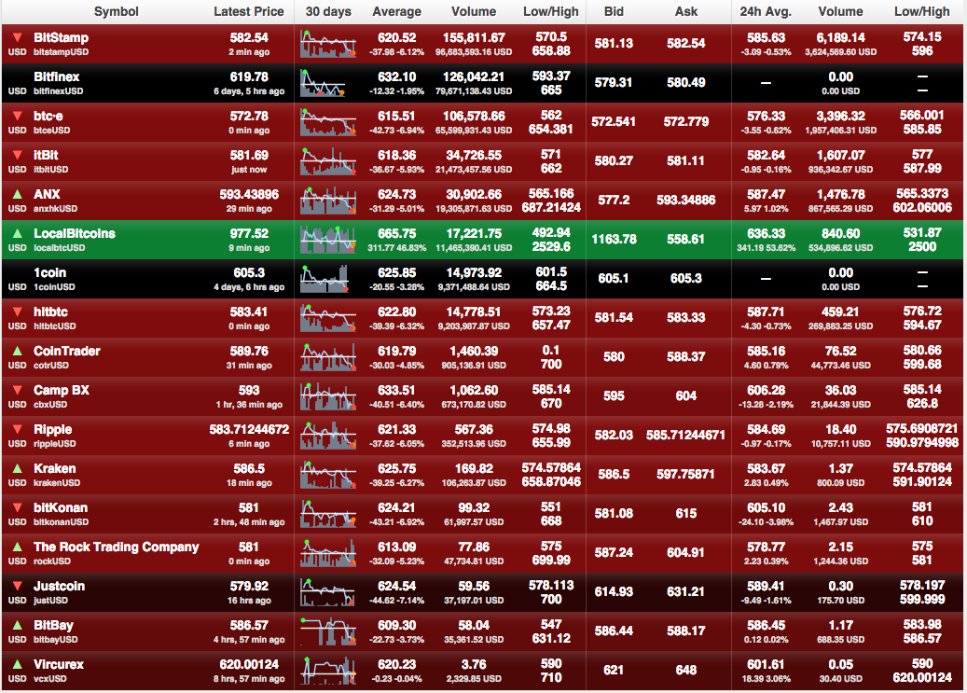
http://bitcoincharts.com/markets

Slide 70
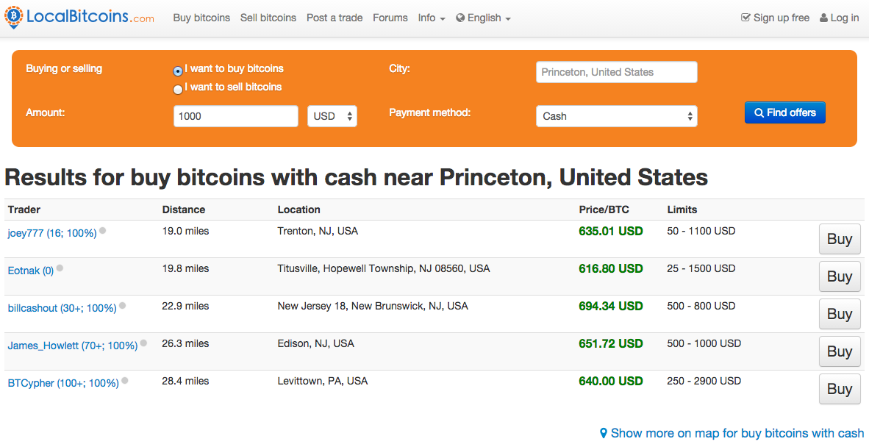

Slide 71


Slide 72
Basic market dynamics
market matches buyer and seller
large, liquid market reaches a consensus price
price set by supply (of BTC) and demand (for BTC)

Slide 73
Supply of Bitcoins
supply = coins in circulation (+ demand deposits?)
coins in circulation: fixed number, currently ~13.1 million
When to include demand deposits?
When they can actually be sold in the market.

Slide 74
Demand for Bitcoins
BTC demanded to mediate fiat-currency transactions
Alice buys BTC for $
Alice sends BTC to Bob
Bob sells BTC for $
BTC demanded as an investment
if the market thinks demand will go up in future
BTC “out of circulation” during this time

Slide 75
Simple model of transaction-demand
T = total transaction value mediated via BTC ($ / sec)
D = duration that BTC is needed by a transaction (sec)
S = supply of BTC (not including BTC held as long-term investments)
S
D
Bitcoins become available per second
Equilibrium:
P =
T
P
TD
Bitcoins needed per second
S

